Slide 1
Database Development & SQL Data Analysis
SQL
Phase 2: Career Track

Slide 2
Topics
Databases: An Overview
Data Modeling and DB Design
1
4
2
5
3
6

Slide 3


Databases: An Overview
What is a Database?
1
A system used to store data?
There are many different ways to store data. A shoe box full of receipts could be used to store data about business expenses. Or a wall full of sticky notes can also be used to store data. But we would NOT consider either of these to be databases

Slide 4
What’s a database then?
01
a system that stores data that can be searched and retrieved/queried
The data along with DBMS and associated applications are often referred to as a database system or just database.
02
often managed and controlled by database management systems (DBMS)
A database is
03
usually stored on large computers called servers or on the cloud but you can also create one on your PC
04
Used in websites, desktop apps, phone apps and

Slide 5
Types of Databases
01
Relational Databases
became dominant in the 1980s. Items in a relational database are organized as a set of tables with columns and rows. Relational database technology provides the most efficient and flexible way to access structured information.
02
NoSQL or Non Relational Databases
allows unstructured and semistructured data to be stored and manipulated. NoSQL databases grew popular as web applications became more common and more complex.
03
Hierarchical Databases
relationships between records are predefined in a one to one manner, between 'parent and child' nodes. They require the user to pass a hierarchy in order to access needed data. Hierarchical database model resembles a tree structure, similar to a folder architecture in your computer system
04
Network Databases
have a hierarchical structure. However, instead of using a single-parent tree hierarchy, this model supports many to many relationships, as child tables can have more than one parent.

Slide 6
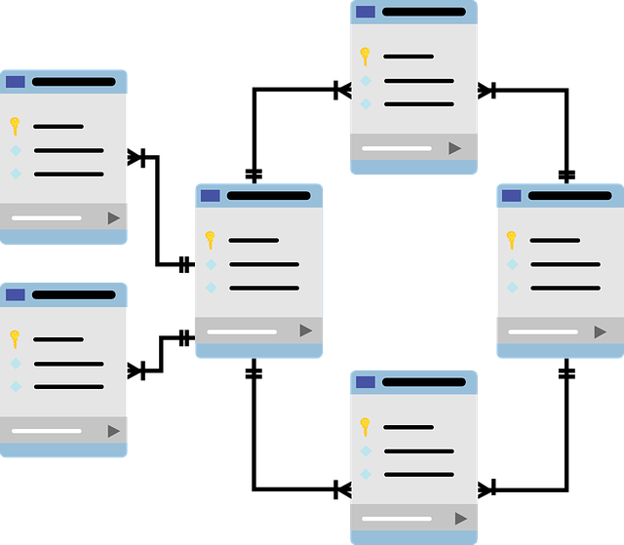
Relational Databases
A relational database is a collection of data items with pre-defined relationships between them. These items are organized as a set of tables with columns and rows.
Tables are used to hold information about the objects to be represented in the database.
Each column in a table holds a certain kind of data and a field stores the actual value of an attribute. The rows in the table represent a collection of related values of one object or entity.
Each row in a table could be marked with a unique identifier called a primary key, and rows among multiple tables can be made related using foreign keys. This data can be accessed in many different ways without reorganizing the database tables themselves.

Slide 7
Aspects of Relational Databases
SQL
Data Integrity
Transactions
ACID Compliance
Structured Query Language
Is the overall completeness, accuracy and consistency of data. Relational databases use a set of constraints to enforce data integrity in the database. These include primary Keys, Foreign Keys, ‘Not NULL’ constraint, ‘Unique’ constraint, ‘Default’ constraint and ‘Check’ constraints. These integrity constraints help enforce business rules on data in the tables to ensure the accuracy and reliability of the data.
transaction is one or more SQL statements that are executed as a sequence of operations that form a single logical unit of work. Relational databases follow “all-or-nothing” approach when executing transactions, meaning that the entire transaction must complete as a single unit & be written to the database (COMMIT) or none of the individual components of the transaction should go through (ROLLBACK)
transactions must be ACID compliant, meaning Atomic, Consistent, Isolated and Durable to ensure data integrity.Atomicity: transaction as a whole be successfully executed or if a part of the transaction fails, then the entire transaction be invalidated. Consistency: data must adhere to all defined rules, and restrictions. Isolation ensures that each transaction is independent. Durability: changes made to the database are permanent.
Is the primary language used to communicate with Relational Databases. SQL is used to add, update or delete rows of data, retrieving subsets of data for transaction processing and analytics applications, and to manage all aspects of the database.

Slide 8

Data Modeling and Database Design
What is data modeling?
2
The process of analysing data requirements and identifying the objects/entities to be used in a database
It is the process of creating a visual representation of data elements and structures and the connection between them. The goal is to illustrate the types of data used and stored within the database, the relationships among these data types, the ways the data can be grouped and organized and its formats and attributes.

Slide 9
Data Modeling Process
High level model showing the r/p b/n objects
Conceptual
More detailed r/p and includes info for each object
Logical
Describes the internal schemas, tables, columns, keys & relationships
Physical
Database

Slide 10
Example Data Model
School Database
First identify all possible objects or tables we need to build the school database and show the relationships between the objects. For the sake of example, let’s assume we only need student and course tables
Student
Course
Conceptual Data Model
Student id
Name
Dob
Enrollment date
Active
Course id
Title
Prerequisite
Level
Now, let’s show the objects at a more detailed level by including more information about our tables by including attributes/columns/fields about the tables
Logical Data Model
student_id INT(10)
name VARCHAR(50)
dob DATE
enrollment_date DATE
Active BOOLEAN
course_id CHAR(10)
title VARCHAR(50)
prerequisite CHAR(10)
level CHAR(10)
Now, it’s time to get down to the nitty-gritty by further defining the actual column names, data types, keys and relationships which will later be translated into production database
Physical Data Model

Slide 11
Why Use Data Model?
accuracy
make certain that data objects are represented accurately.
relationship
defining the relationship between tables, primary and foreign keys, and stored procedures.
Identify data sources
recognize correct sources of data to populate the model
Blue print
Serves as a blueprint to build the actual database

Slide 12
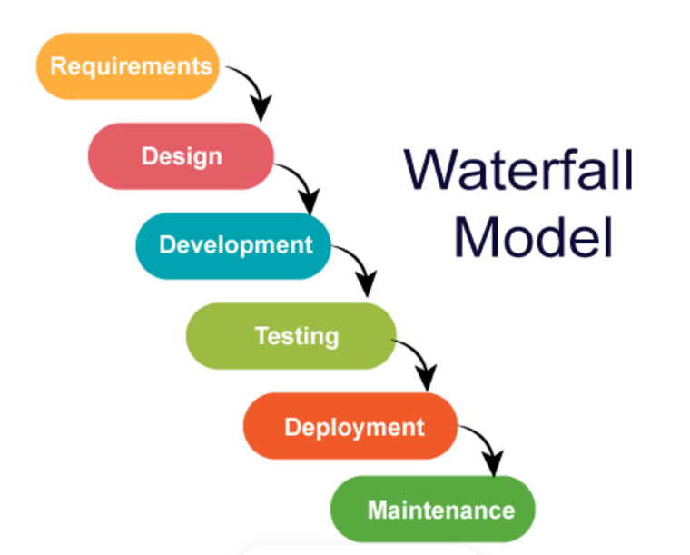
The Software Development Life Cycle
A core aspect of software development is the subdivision of the development process into a series of phases, or steps, each of which focuses on one aspect of the development. The collection of these steps is sometimes referred to as the software development life cycle (SDLC). Database development, like any other computer system development, also follows the same life cycle
To this effect, we use the waterfall process as a means of identifying the tasks that are required, together with the input and output for each activity.

Slide 13
Requirements Gathering
Measure twice, cut once!
REMEMBER: when developing a system from the start, it is always easier to design things according to the system requirements than changing things in the existing system once it’s built!
Before you start your work and get your hands dirty in database designing, it is very important to gather the complete requirements of the system.
Requirements gathering is the very first and crucial step in database development. You have to gather requirements by interviewing stakeholders or end users of the database and by reviewing documents to understand the proposed system and obtain and document the data and functional requirements. This step is very important because if once you have built the database and if you there is something missing or not properly built, then it would be so difficult and very costly to change the things in the existing system.
You have 2 information sources to gather requirements:
1. Stakeholders/people via interviews
2. Documentations

Slide 14
Class Activity
Build a data model and design a database for Datanomics Academy!
Requirement gathering:
Understand the needs and requirements of stakeholders
Analyze and discuss the requirements
Data modelling:
Identify all the requirement tables
Identify all the columns for each tabel
Determine size, or length, of the column in bytes
Determine the constraints for each column
Identify the keys–primary and foreign key
Build the entity relationships diagram (ER diagram)
Implementation: NEXT class activity

Slide 15
Databases Normalization
3
Normalization is he process of efficiently organizing data in a database by dividing larger tables into smaller tables and linkinging them using relationships. Normalization helps us achieve two fundamental goals:
1. Reduce redundant/duplicate data
2. Eliminate insertion, deletion and update anomalies
Both goals are crucial as they reduce the amount of space a database consumes and ensure that data is logically stored, ultimately improving the database performance.

Slide 16
Levels of Normalization
1NF
2NF
3NF
4NF
Be in 1NF
All the columns depend on the primary key
Be in 2NF
Contain non-transitively dependent columns
Each table cell should contain a single value.
Each record needs to be unique.

Slide 17
The Client-Server Model
All relational database management systems operate on a client-server model–two components that work together to form a complete system
Database Server
Client/Interface
Performs all relational database management tasks
Structures, stores and secures data
Allows users to connect and control activities
Can be text best, graphical or a custom written application

Slide 18


Database: Client and Server
Database Server
Client/Interface

Slide 19
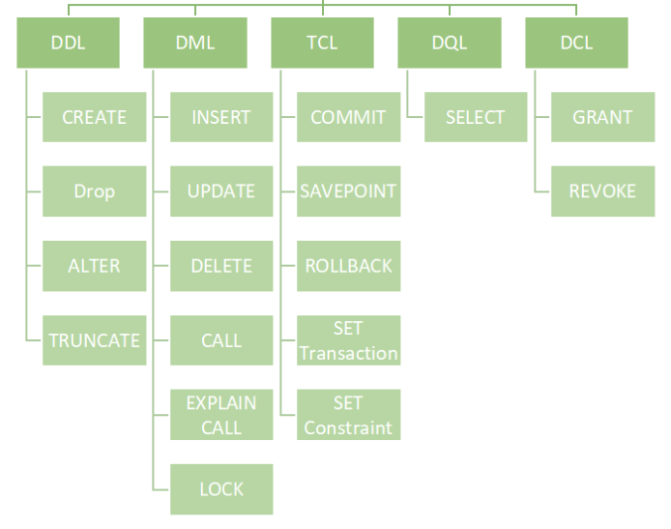
Working with SQL
SQL

Slide 20
SQL-DQL
The SELECT statement along with corresponding clauses make up the Data Query Language of SQL. DQL statements are used to retrieve data out of the database to perform various analyses. The following are the most commonly clauses that can be used with the SELECT statement:
FROM
Used to specify table(s)
WHERE
used to filter rows from a table
ORDER BY
Used to sort rows
LIMIT
used to select a subset of rows from the table
GROUP BY
used to group different rows into a single group
HAVING
used to filter rows from a table with specified attributes or features.
FETCHD
used to specifies the number of rows to skip before any rows are retrieved

Slide 21
The WHERE Clause–the IN Operator
The IN operator is used to specify the list of values or sub query in the WHERE clause.
A sub-query or list of values must be specified in the parenthesis
e.g. IN (value1, value2, ...) or IN (Select query).
Use the NOT operator with the IN operator to filter records that do not fall in the specified values.
e.g. NOT IN (value1, value2, ...) or IN (Select query).

Slide 22
The WHERE Clause–the BETWEEN Operator
The BETWEEN operator is used in the WHERE conditions to filter records within the specified range. The range of values can be strings, numbers, or dates.
The range of values must be specified with the AND operator.
WHERE column BETWEEN begin_value AND end_value
If the value is greater than or equal to the low value and less than or equal to the high value, the expression returns true, otherwise, it returns false. Which means, the BETWEEN operator could also be rewritten as :
WHERE column begin_value>= AND column <= end_value

Slide 23
The WHERE Clause–the LIKE Operator
The LIKE operator is used in a WHERE clause to search for a specified pattern in a column.
There are two wildcards often used in conjunction with the LIKE operator:
The percent sign (%) represents zero, one, or multiple characters
The underscore sign (_) represents one, single character

Slide 24
The WHERE Clause–the IS NULL Operator
IS NULL operator evaluates true if the value in a column is NULL or false if it is not.
NULL means missing information or not applicable. NULL is not a value, therefore, you cannot compare it with any other values like numbers or strings. The comparison of NULL with a value will always result in NULL, which means an unknown result.
In SQL NULL, 0, and blank represent completely different values and using these values incorrectly or choosing the wrong one can have enormous ramifications on the accuracy of your analysis

Slide 25
QUERYING SINGLE TABLE
Fetch all columns from the country table:
SELECT *
FROM country;
Fetch city_id and city columns from the city table:
SELECT city_id, city
FROM city;
Fetch film titles sorted by the length column in the default ASCending order:
SELECT title
FROM film
ORDER BY length [ASC];
Fetch payments from the payment table sorted by the amount column in the DESCending order:
SELECT amount
FROM payment
ORDER BY amount DESC;

Slide 26
ALIASES
SQL aliases are used to give a table, or a column in a table, a temporary name.
Aliases are often used to make column names more readable.
COLUMNS ALIASES
SELECT rental_duration AS duration
FROM film;
TABLES ALIASES
SELECT ci.city, co.country
FROM city AS ci
JOIN country AS co
ON ci.country_id = co.country_id;

Slide 27
FILTERING THE OUTPUT
COMPARISON OPERATORS
Fetch names of cities that have a rating above 3:
SELECT city
FROM city
WHERE city_id> 3;
Fetch names of cities that are neither Berlin nor Madrid:
SELECT city
FROM city
WHERE city != 'Berlin'
AND city!= 'Madrid';

Slide 28
FILTERING THE OUTPUT
TEXT OPERATORS
Fetch names of cities that start with a 'P' or end with an 's':
SELECT first_name
FROM actor
WHERE name LIKE 'P%'
OR name LIKE '%s';
Fetch names of cities that start with any letter followed by 'ublin' (like Dublin in Ireland or Lublin in Poland):
SELECT city
FROM city
WHERE city LIKE '_ublin';

Slide 29
FILTERING THE OUTPUT
OTHER OPERATORS
Fetch titles of movies that have length between 100 and 150 minutes
;
Fetch first names of customers who are not active:
Fetch names of cities that are in countries with IDs 1, 4, 7, or 8:

Slide 30
SUBQUERIES
A subquery is a query that is nested inside another query, or inside another subquery. There are different types of subqueries.
SINGLE VALUE
The simplest subquery returns exactly one column and exactly one row. It can be used with comparison operators =, <, <=, >, or >=.
This query finds cities with the same rating as Paris:
SELECT title
FROM film
WHERE length= (
SELECT length
FROM film
WHERE title= "Spy Mile"
);

Slide 31
SUBQUERIES
MULTIPLE VALUES
A subquery can also return multiple columns or multiple rows. Such subqueries can be used with operators IN, EXISTS, ALL, or ANY.
This query finds cities in countries that have a population above 20M:
SELECT name
FROM city
WHERE country_id IN (
SELECT country_id
FROM country
WHERE population > 20000000
);

Slide 32
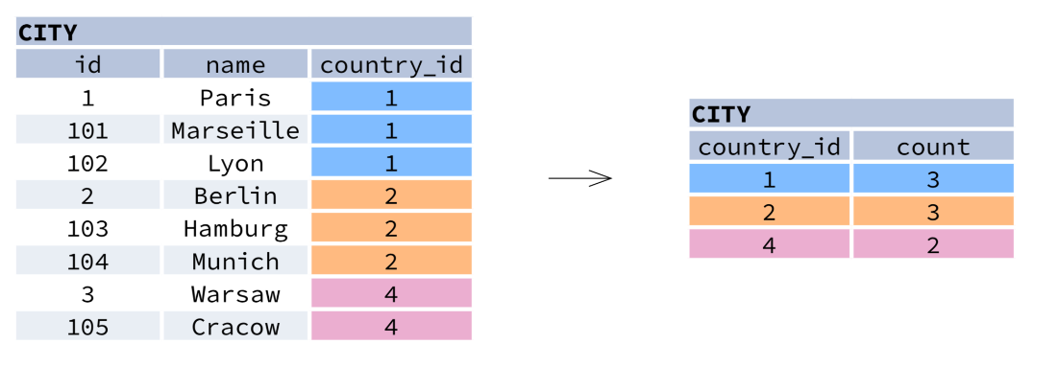
AGGREGATION AND GROUPING
GROUP BY groups together rows that have the same values in specified columns. It computes summaries (aggregates) for each unique combination of values.

Slide 33
AGGREGATION AND GROUPING
AGGREGATE FUNCTIONS
AVG() − average value for rows within the group
COUNT() − count of values for rows within the group
MAX() − maximum value within the group
MIN() − minimum value within the group
SUM()− sum of values within the group

Slide 34
AGGREGATION AND GROUPING
EXAMPLE QUERIES
Find out the number of cities:
SELECT COUNT(*)
FROM city;
Find out the number of distinctive country values:
SELECT COUNT(DISTINCT country_id)
FROM city;

Slide 35
AGGREGATION AND GROUPING
EXAMPLE QUERIES
Find out the smallest and the greatest country populations:
SELECT MIN(rental_rate), MAX(rental_rate)
FROM film;
Find out the total population of cities in respective countries:
SELECT payment_date, SUM(amount)
FROM payment
GROUP BY payment_date;
Find out the average rental rate for films under each rating category, i.e PG, G etc

Slide 36
QUERYING MULTIPLE TABLES
INNER JOIN
JOIN (or explicitly INNER JOIN) returns rows that have matching values in both tables.
SELECT city.name, country.name
FROM city
[INNER] JOIN country
ON city.country_id = country.id;
LEFT JOIN
LEFT JOIN returns all rows from the left table with corresponding rows from the right table. If there's no matching row, NULLs are returned as values from the second table.
SELECT city.name, country.name
FROM city
LEFT JOIN country
ON city.country_id = country.id;

Slide 37
QUERYING MULTIPLE TABLES
;RIGHT JOIN
RIGHT JOIN returns all rows from the right table with corresponding rows from the left table. If there's no matching row, NULLs are returned as values from the left table.
SELECT city.name, country.name
FROM city
RIGHT JOIN country
ON city.country_id = country.id;
FULL JOIN
FULL JOIN (or explicitly FULL OUTER JOIN) returns all rows from both tables – if there's no matching row in the second table, NULLs are returned.
SELECT city.name, country.name
FROM city
FULL [OUTER] JOIN country
ON city.country_id = country.id;

Slide 38
QUERYING MULTIPLE TABLES
CROSS JOIN
CROSS JOIN returns all possible combinations of rows from both tables. There are two syntaxes available.
SELECT city.name, country.name
FROM city
CROSS JOIN country;
SELECT city.name, country.name
FROM city, country;

Slide 39
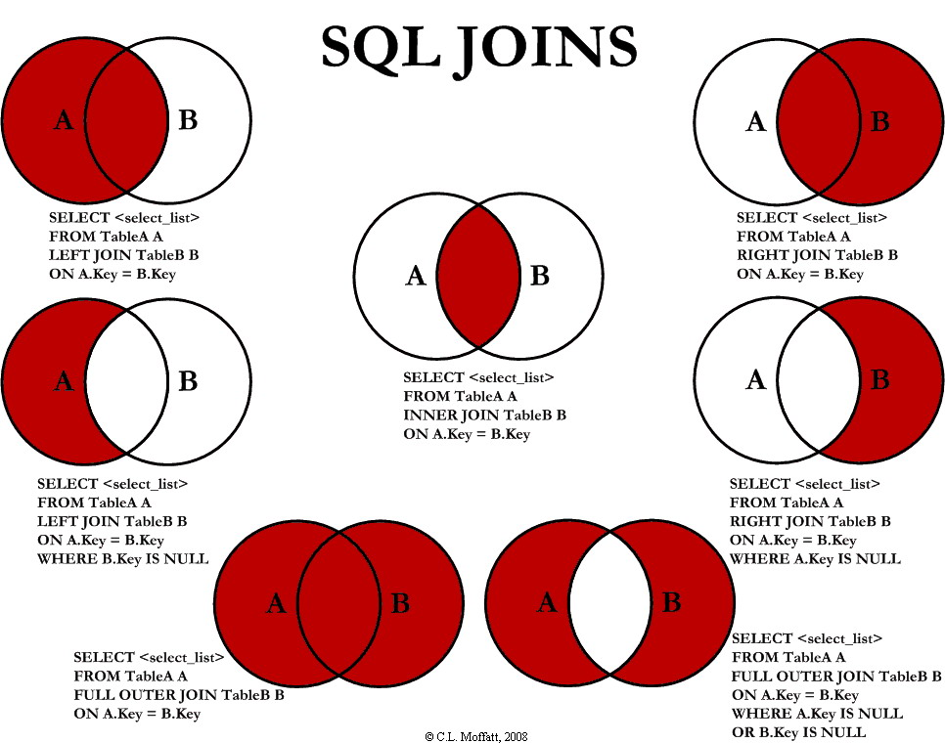
QUERYING MULTIPLE TABLES

Slide 40

SET OPERATIONS
Set operations are used to combine the results of two or more queries into a single result. The combined queries must return the same number of columns and compatible data types. The names of the corresponding columns can be different
UNION
UNION combines the results of two result sets and removes duplicates. UNION ALL doesn't remove duplicate rows.
This query displays German cyclists together with German skaters:
SELECT name
FROM cycling
WHERE country = 'DE'
UNION / UNION ALL
SELECT name
FROM skating
WHERE country = 'DE';

Slide 41

SET OPERATIONS
INTERSECT
INTERSECT returns only rows that appear in both result sets.
This query displays German cyclists who are also German skaters at the same time:
SELECT name
FROM cycling
WHERE country = 'DE'
INTERSECT
SELECT name
FROM skating
WHERE country = 'DE';

Slide 42

SET OPERATIONS
EXCEPT
EXCEPT returns only the rows that appear in the first result set but do not appear in the second result set.
This query displays German cyclists unless they are also German skaters at the same time:
SELECT name
FROM cycling
WHERE country = 'DE'
EXCEPT / MINUS
SELECT name
FROM skating
WHERE country = 'DE';

Slide 43
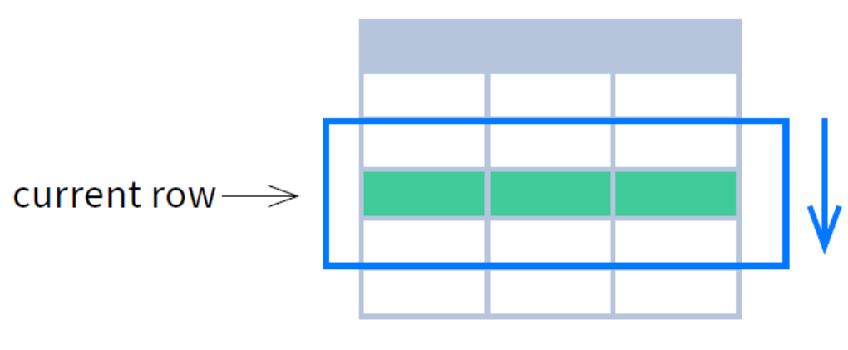
WINDOW FUNCTIONS
Window functions compute their result based on a sliding window frame, a set of rows that are somehow related to the current row.

Slide 44
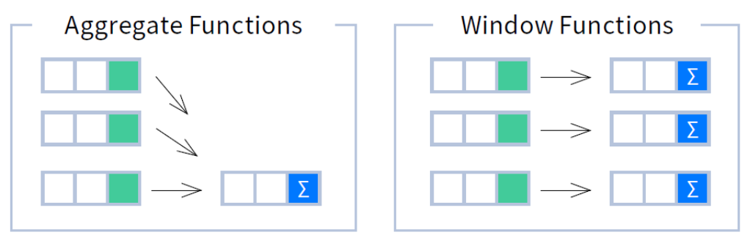
WINDOW FUNCTIONS
Aggregate Functions vs. Window Functions
Unlike aggregate functions, window functions do not collapse rows.

Slide 45
WINDOW FUNCTIONS
Aggregate Functions vs. Window Functions
Unlike aggregate functions, window functions do not collapse rows.

Slide 46
WINDOW FUNCTIONS
Syntax
SELECT <column_1>, <column_2>,
<window_function>() OVER <window_name>
FROM <table_name>
WHERE <...>
GROUP BY <...>
HAVING <...>
WINDOW <window_name> AS (
PARTITION BY <...>
ORDER BY <...>
<window_frame>)
ORDER BY <...>;
SELECT <column_1>, <column_2>,
<window_function>() OVER <window_name>
FROM <table_name>
WHERE <...>
GROUP BY <...>
HAVING <...>
WINDOW <window_name> AS (
PARTITION BY <...>
ORDER BY <...>
<window_frame>)
ORDER BY <...>;
PARTITION BY, ORDER BY, and window frame definition are all optional.

Slide 47
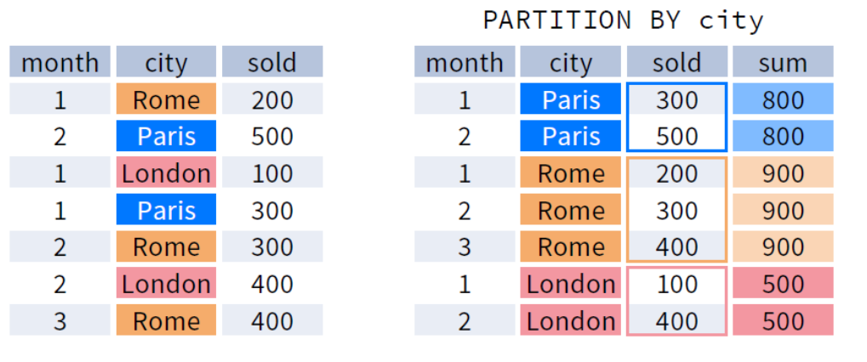
PARTITION BY
PARTITION BY divides rows into multiple groups, called partitions, to which the window function is applied.
Default Partition: With no PARTITION BY clause, the entire result set is the partition.

Slide 48
WINDOW FUNCTIONS
Syntax
SELECT <column_1>, <column_2>,
<window_function> OVER (
PARTITION BY <...>
ORDER BY <...>
<window_frame>) <window_column_alias>
FROM <table_name>;
SELECT staff_id, payment_date,
sum(sold) OVER (
PARTITION BY city
ORDER BY payment_date
RANGE UNBOUNDED PRECEDING) total_daily_sales
FROM payment;

Slide 49
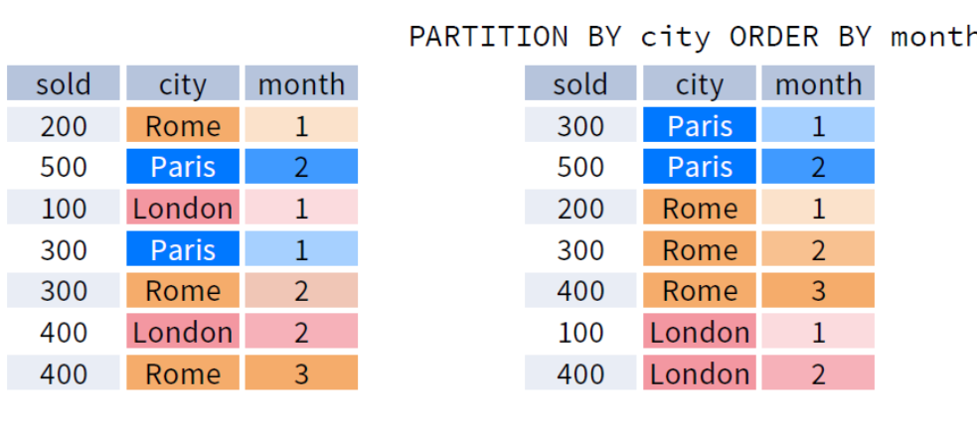
ORDER BY
ORDER BY specifies the order of rows in each partition to which the window function is applied.
Default ORDER BY: With no ORDER BY clause, the order of rows within each partition is arbitrary.

Slide 50
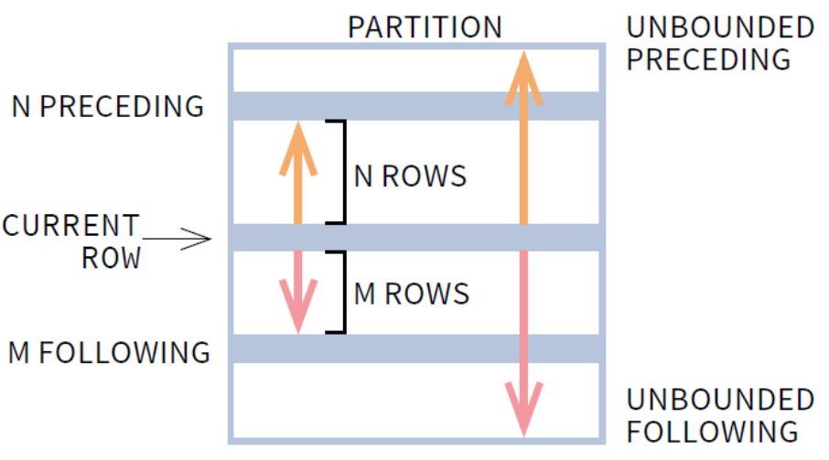
Window Frame
A window frame is a set of rows that are somehow related to the current row. The window frame is evaluated separately within each partition.
Default ORDER BY: With no ORDER BY clause, the order of rows within each partition is arbitrary.

Slide 51
Window Frame
ROWS | RANGE | GROUPS BETWEEN lower_bound AND upper_bound
The bounds can be any of the five options:
UNBOUNDED PRECEDING
n PRECEDING
CURRENT ROW
n FOLLOWING
UNBOUNDED FOLLOWING
The lower_bound must be BEFORE the upper_bound
Default ORDER BY: With no ORDER BY clause, the order of rows within each partition is arbitrary.

Slide 52
SQL functions
Aggregate functions
  Count
  Sum
  Average
  Min and Max
Mathematical functions
  Absolute
  Ceil and Floor
  Truncate
  Modulo
String functions
  Lower and Upper
  Concat
  Trim

Slide 53
SQL functions
Date and Time functions
  Date and Time
  Extract
  Date format
Windows functions
  Rank
  Percent value
  Nth value
Miscellaneous functions
  Convert
  Isnull
  If

Slide 54
SQL Syntax Order
The SELECT statement along with corresponding clauses make up the Data Query Language of SQL. DQL statements are used to retrieve data out of the database to perform various analyses. The following are the most commonly clauses that can be used with the SELECT statement:
FROM
WHERE
ORDER BY
LIMIT
GROUP BY
HAVING
FETCHD clause

Slide 55
SQL-Order of Execution
The SELECT statement along with corresponding clauses make up the Data Query Language of SQL. DQL statements are used to retrieve data out of the database to perform various analyses. The following are the most commonly clauses that can be used with the SELECT statement:
FROM
WHERE
ORDER BY
LIMIT
GROUP BY
HAVING
FETCHD clause

Slide 56
REFERENCES
Data Modeling, creating an ER diagram, is a common task when you are working with databases–especially when building one. This task can be done using pen and paper, or a whiteboard but there are special purpose tools or softwares that are meant for data modelling. There are actually lots of these types of tools. Here are the most popular ones:
  QuickDBD: QuickDBD is an online tool that allows you to draw database diagrams by typing. There’s a panel that lets you enter text in a format that looks like SQL but much simpler. It is then converted to a database diagram.www.quickdatabasediagrams.com/
  Dbdiagram.io (Free for up to 10 diagrams. After that, it’s $9/month) -www.dbdiagram.io
  Lucidchart: It’s an online diagramming tool that offers a range of drawing types, such as flowcharts and database diagrams.It’s free with limited objects, but required subscription for more features–$4.95-$9.00/user/month. www.lucidchart.com
  Miro-www.miro.com

